Slide 1





SENSORED 9.0
IR SENSORS

Slide 2



Let’s START the Theoretical basics of the
IR sensor !!!

Slide 3
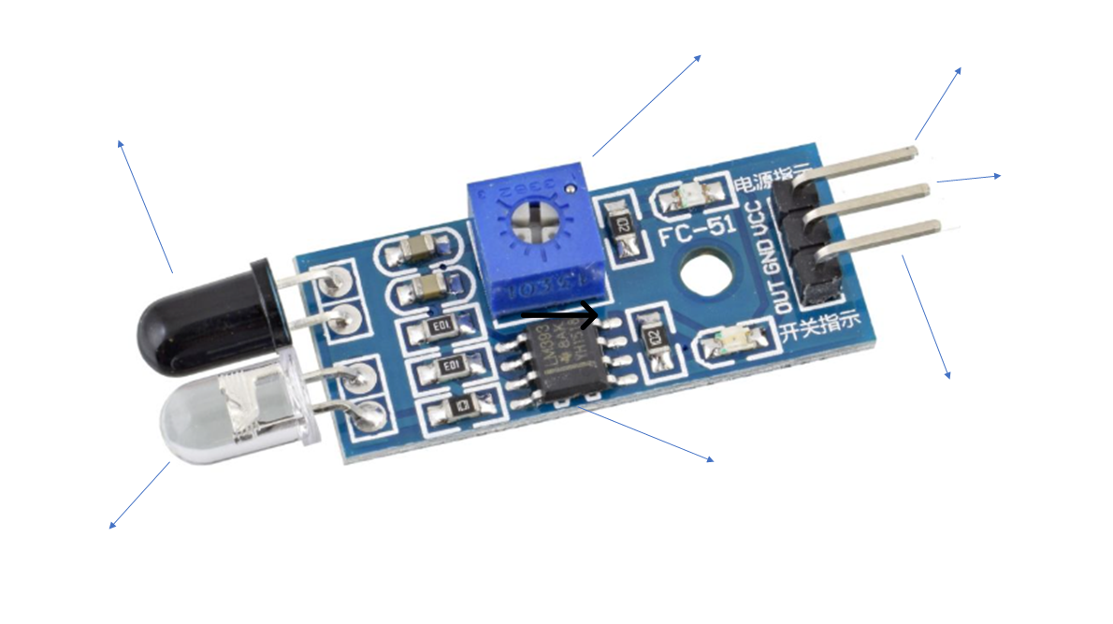
Parts of an IR Sensor
Sensitivity
Manipulator
5V collector current
pin
Receiver photodiode
Ground
pin
Data Pin
LM393 IC
LED

Slide 4
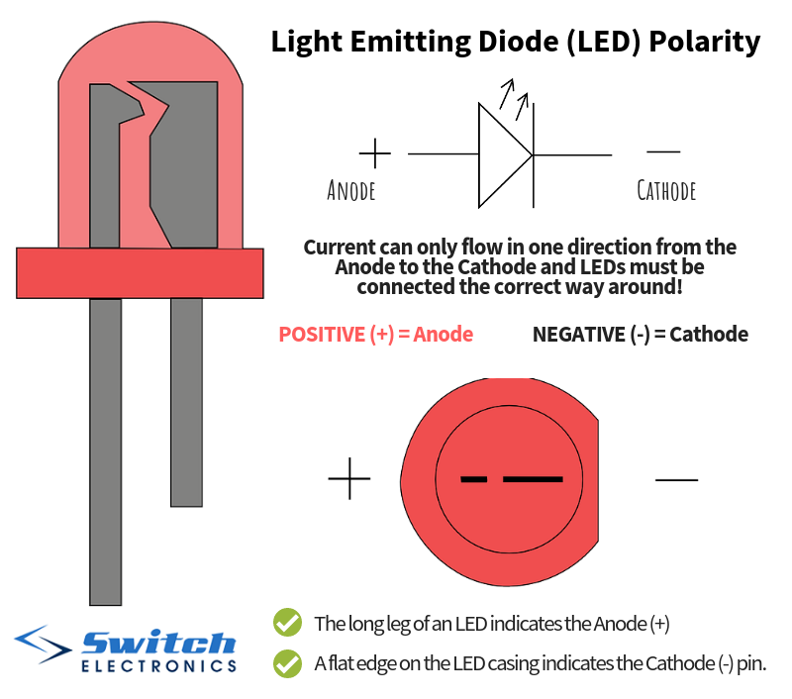
PARTS OF THE IR LED
Long lead ----→ Anode (+)
Short lead ---→ Cathode (-)

Slide 5
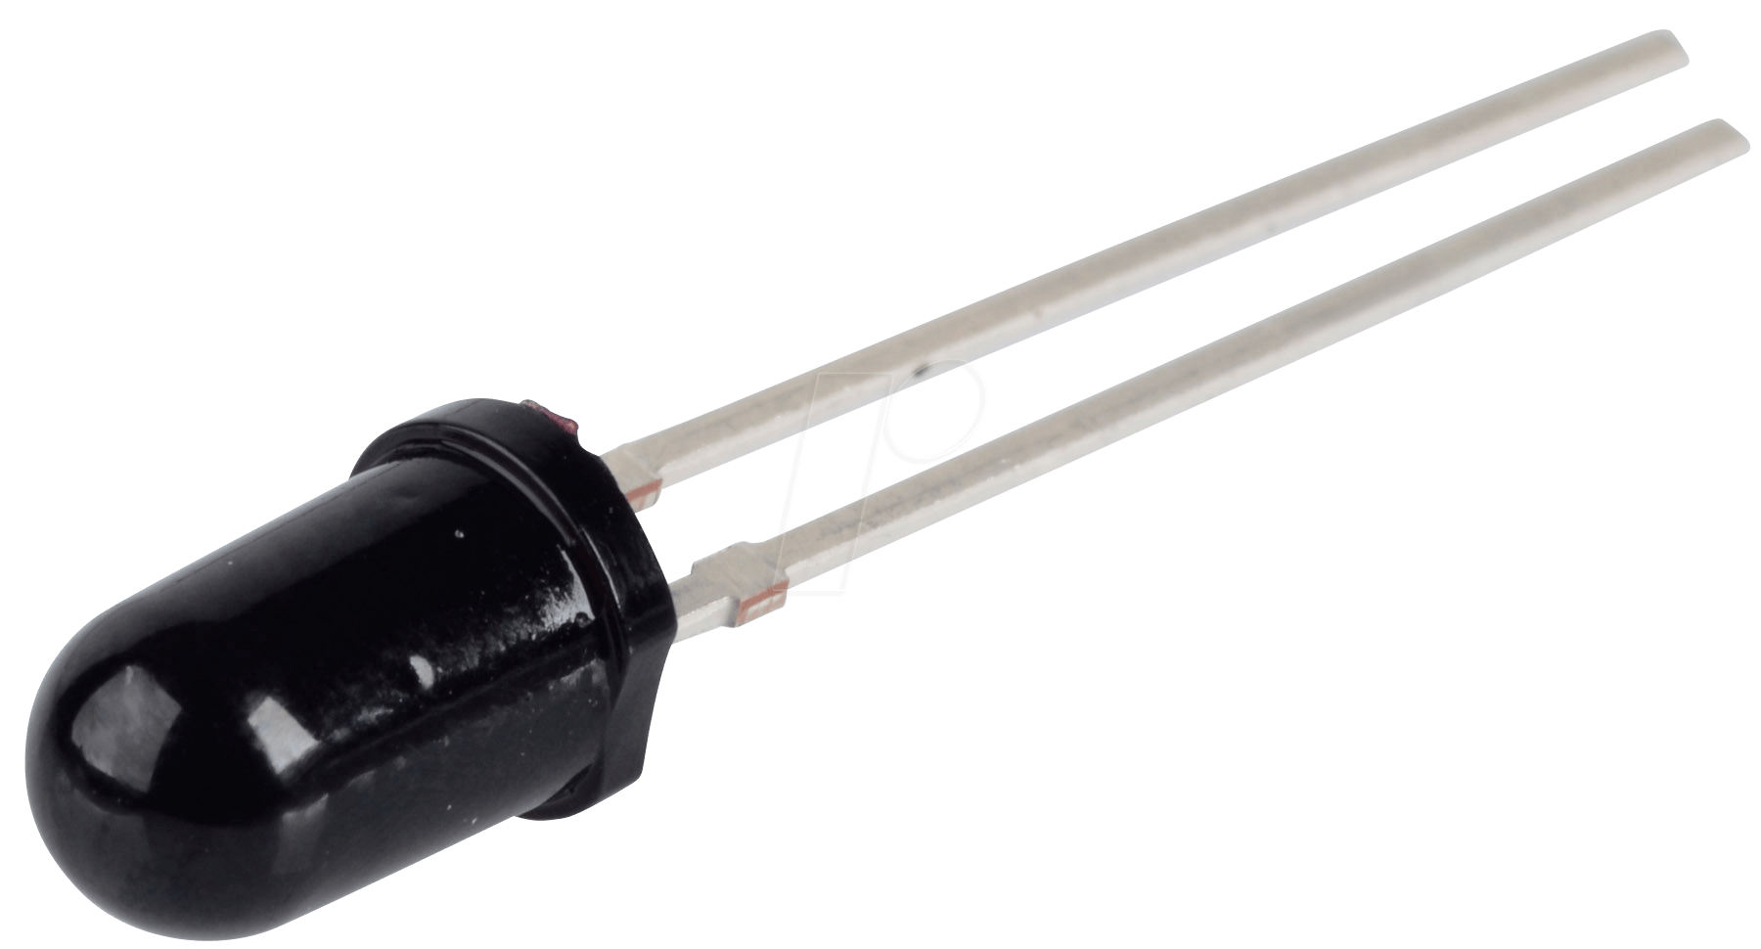
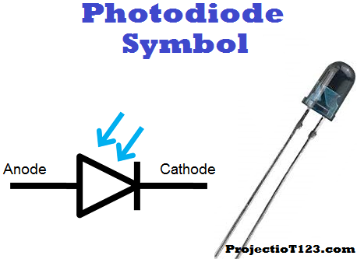
PHOTODIODE
Absorb the radiation → Photocurrent generation →Conversion to voltage
Long lead ----→ Anode (+)
Short lead ---→ Cathode (-)

Slide 6

Why is the photodiode black ?

Slide 7
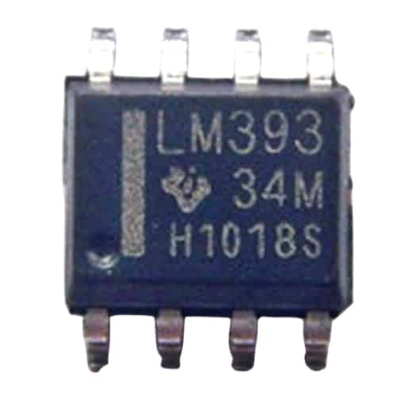
DUAL DIFFERENTIAL COMPARATOR(LM393)
Received Voltage > Reference Voltage : Outputs the signal
Else : Ignores the object

Slide 8
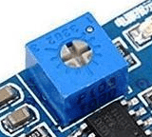
Potentiometer
Clockwise : Increase reference voltage
Counter clockwise : Decrease reference voltage

Slide 9
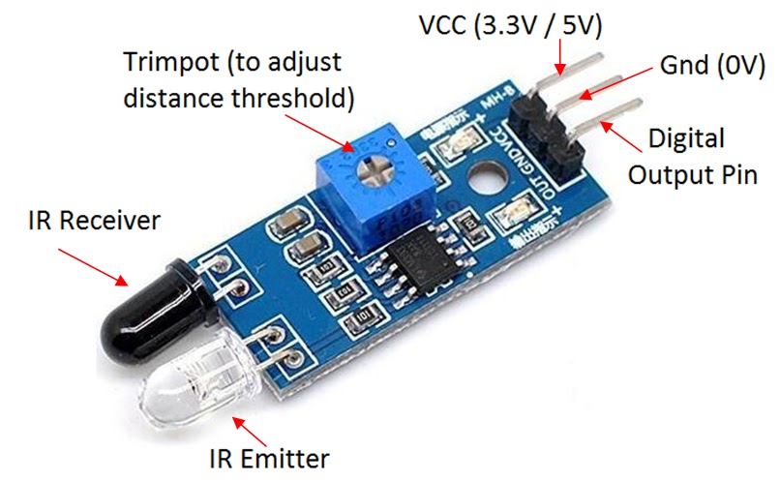
CONNECTING PINS

Slide 10
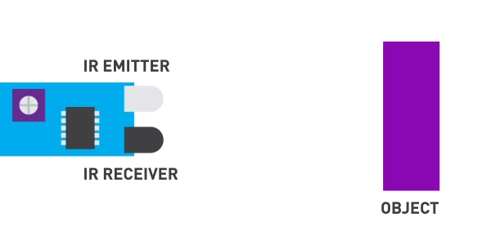
Theory of IR Sensor

Slide 11
Parts of an IR Sensor
Sensitivity
Manipulator
5V collector current
pin
Receiver photodiode
Ground
pin
Data Pin
LM393 IC
LED

Slide 12
Any doubts guys?

Slide 13
You Buy a product only if it’s useful to you in some way or the other.
So let’s discuss the real-life applications of the IR Sensor…

Slide 14
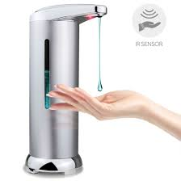


Do you know how these work?
Automatic soap dispenser
Automatic door

Slide 15
Unreliable in ambient conditions
Penetration power and low frequency
drawbacks
Drawbacks of IR Sensor
Unreliable in environmental conditions
IR ray at high power can damage your eyes
IR region is very small (700-1000nm)
Sensor range is very low
If the object is black then the IR sensor module might not
sense it.

Slide 16
Unreliable in ambient conditions
Penetration power and low frequency
Projects using IR sensor
Any creative ideas?

Slide 17
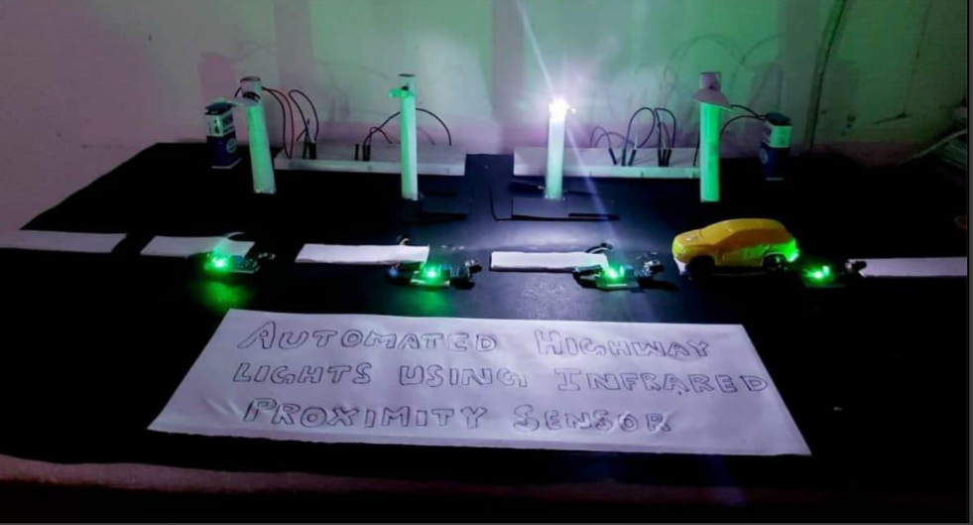
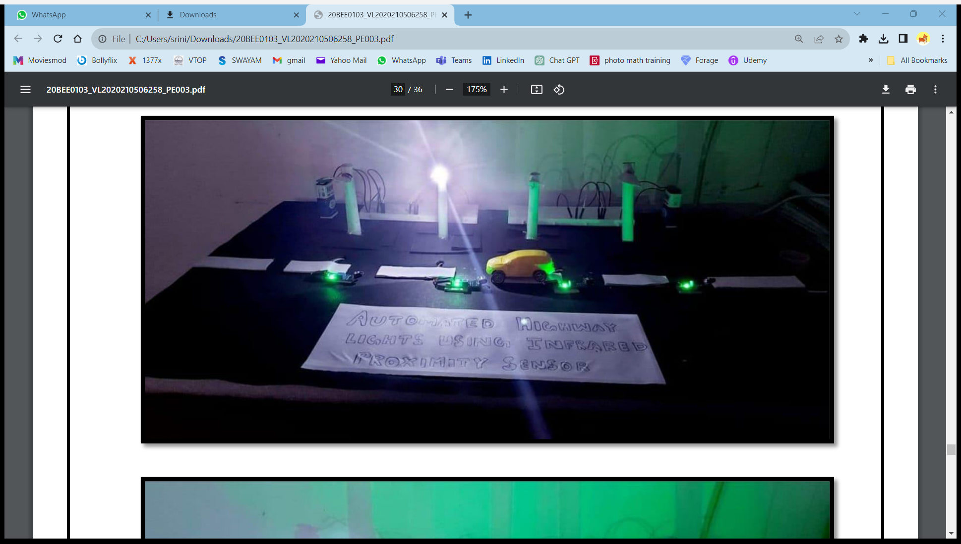
Interesting projects
Traffic signal project:
Black line following robot
IR contactless bell

Slide 18
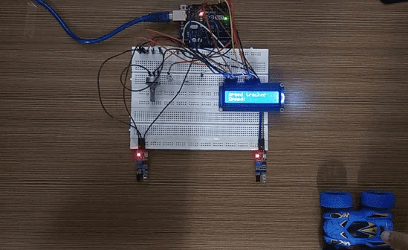
Interesting projects
Vehicle speed detector project:
Black line following robot
IR contactless bell

Slide 19
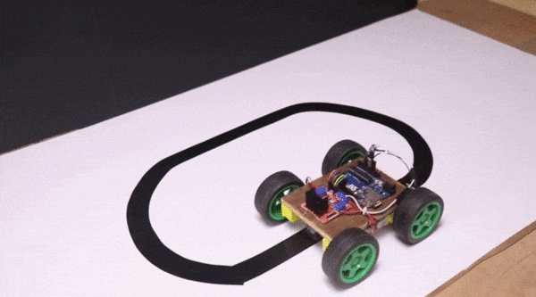
Interesting projects
Vehicle speed detector project:

Slide 20

ARE YOU GUYS READY FOR THE CODING AND HANDS ON PART ???

Slide 21
CODE
#define SENSOR_PIN 18
void setup() {
Serial.begin(9600); //This initializes the serial communication at a baud rate of 9600 bits per second.
pinMode(SENSOR_PIN, INPUT); //sets SENSOR_PIN(pin 18) as input
}
void loop() {
int state = digitalRead(SENSOR_PIN); //reads the value from SENSOR_PIN
if (state == HIGH)
Serial.println("The obstacle is present");
else
Serial.println("The obstacle is NOT present");
delay(100); //introduces a delay of 100 milliseconds between consecutive sensor readings
}
}
.

Slide 22
READY FOR THE CONNECTIONS SEGMENT?

Slide 23
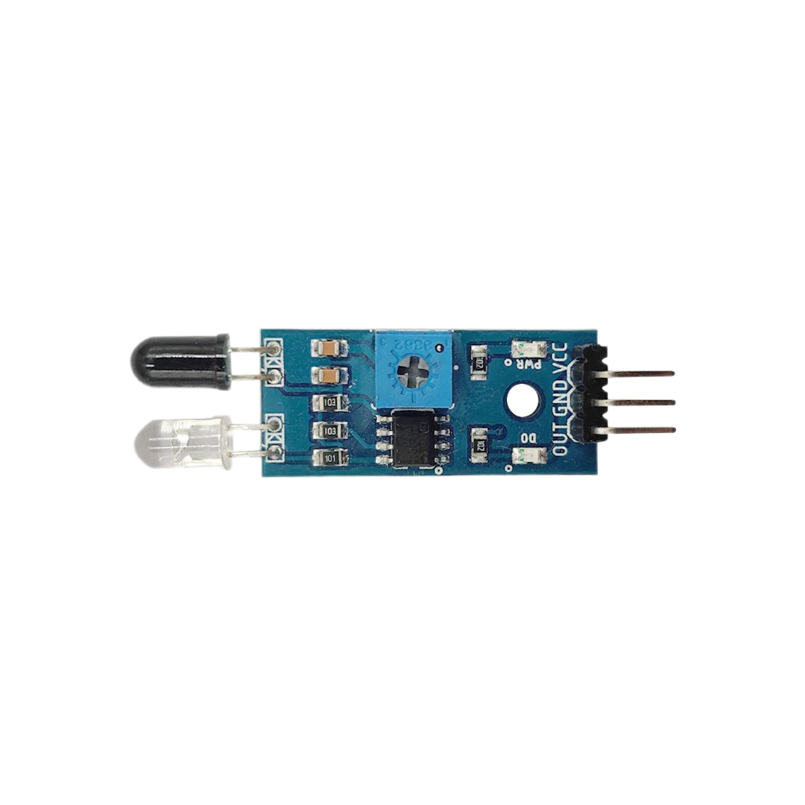
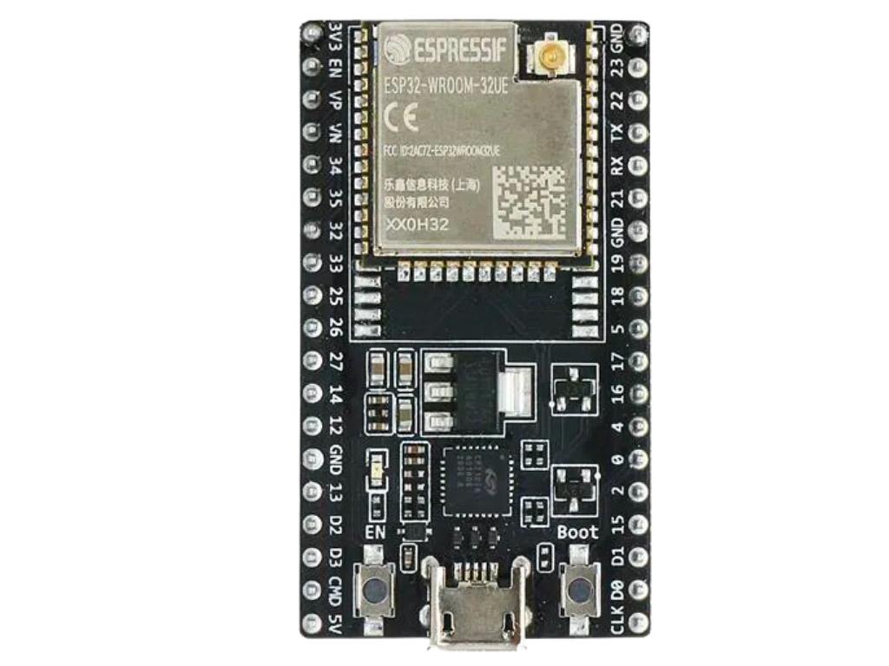

Slide 24

THANK YOU

Slide 25
Speaker
Devadarsh Prakash

